Slide 1
Object Oriented Programming (OOP)
Week – 02
Dated: dd/mm/yyyy
Instructor: AHMED AWAIS

Slide 2
Structure v/s Class

Slide 3
Structs in Java – does Java support?
No, Java does not have a struct type like some other programming languages, such as C or C++. In C/C++, struct is used to define a simple data structure that can group different types of variables under one name, without methods or behavior associated with it.However, in Java, the concept of a struct can be replaced with classes.
Next Slide explain struct for your better understanding the difference between Struct and Classes

Slide 4
struct versus class
In C++ struct and class can be used interchangeably to create a class with one exception
What if we forget to put an access modifier before the first field?
struct Robot { OR class Robot {
float locX; float locX;
In a class, until an access modifier is supplied, the fields are assumed to be private
In a struct, the fields are assumed to be public

Slide 5
Main Lecture Slides

Slide 6
INFORMATION HIDING
Information is stored within the object
It is hidden from the outside world
It can only be manipulated by the object itself

Slide 7


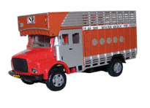
Example

Slide 8
Encapsulation (1st Principle of OOP)
Encapsulation is a process of wrapping of data and methods in a single unit
The main advantage of using of encapsulation is to secure the data from other methods, when we make a data private then these data only use within the class, but these data not accessible outside the class.

Slide 9
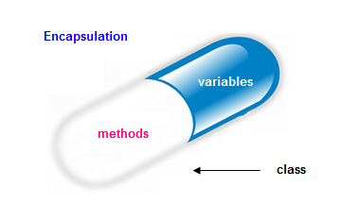
Real Life Example of Encapsulation
The common example of encapsulation is Capsule. In capsule all medicine are encapsulated inside capsule.

Slide 10
Real Life Example of Encapsulation
A Phone stores phone numbers in digital format and knows how to convert it into human-readable characters
We don’t know
How the data is stored
How it is converted to human-readable characters

Slide 11
ENCAPSULATION – ADVANTAGES
Simplicity and clarity
Low complexity
Better understanding

Slide 12
Abstraction in OOP (2nd Principle)
Abstraction is selecting data from a larger pool to show only the relevant details to the object.
Abstraction is a way to cope with complexity.
Principle of abstraction:
“Capture only those details about an object that are relevant to current perspective”

Slide 13
Example – Abstraction
Ali is a PhD student and teaches BS students
Attributes
- Name - Employee ID
- Student Roll No - Designation
- Year of Study - Salary
- CGPA - Age

Slide 14
Example – Abstraction
Ali is a PhD student and teaches BS students
Behavior
- Study - DevelopExam
- GiveExam - TakeExam
- PlaySports - Eat
- DeliverLecture - Walk

Slide 15
Example – Abstraction
Student’s Perspective
Attributes
- Name - Employee ID
- Student Roll No - Designation
- Year of Study - Salary
- CGPA - Age

Slide 16
Example – Abstraction
Student’s Perspective
Behavior
- Study - DevelopExam
- GiveExam - TakeExam
- PlaySports - Eat
- DeliverLecture - Walk

Slide 17
Example – Abstraction
Teacher’s Perspective
Attributes
- Name - Employee ID
- Student Roll No - Designation
- Year of Study - Salary
- CGPA - Age

Slide 18
Example – Abstraction
Teacher’s Perspective
Behavior
- Study - DevelopExam
- GiveExam - TakeExam
- PlaySports - Eat
- DeliverLecture - Walk

Slide 19
Example – Abstraction
A cat can be viewed with different perspectives
Ordinary Perspective
A pet animal with
Four Legs
A Tail
Two Ears
Sharp Teeth
Surgeon’s Perspective
A being with
A Skeleton
Heart
Kidney
Stomach

Slide 20


Example – Abstraction
Driver’s View
Engineer’s View

Slide 21
Abstraction – Advantages
Simplifies the model by hiding irrelevant details
Abstraction provides the freedom to defer implementation decisions by avoiding commitment to details

Slide 22
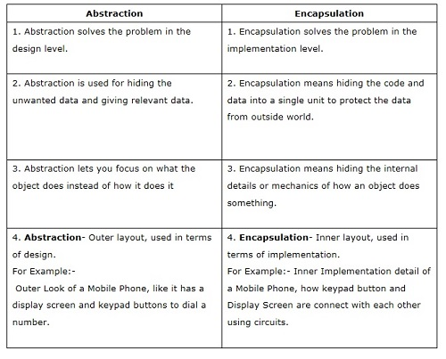

Slide 23
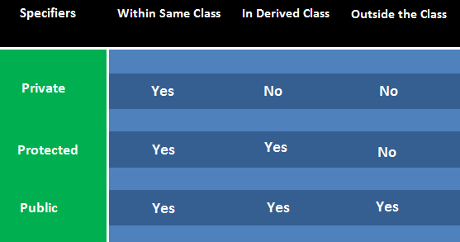
Access Specifiers/Modifiers
Public
Private
Protected

Slide 24
Syntax
class
{
private:
// private members and function
public:
// public members and function
protected:
// protected members and function
};

Slide 25
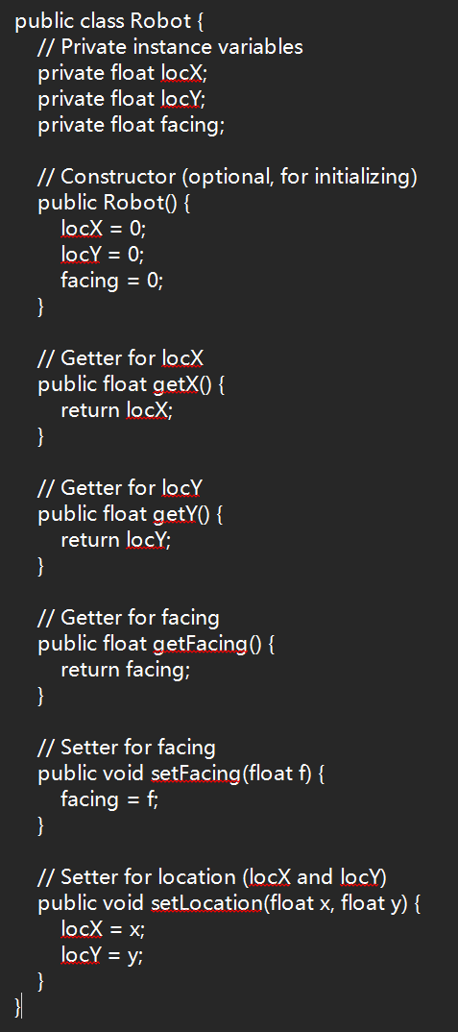
A Simple Class
class Robot {
public:
float getX() { return locX; }
float getY() { return locY; }
float getFacing() { return facing; }
void setFacing(float f) { facing = f; }
void setLocation(float x, float y);
private:
float locX;
float locY;
float facing;
};

Slide 26
private Access Modifier
Fields marked as private can only be accessed by functions that are part of that class
In the Robot class, locX, locY, and facing are private float fields, these fields can only be accessed by functions that are in class Robot (getX, getY, getFacing, setFacing, setLocation)
Example:
void useRobot() {
Robot r1;
r1.locX = -5; // Error

Slide 27
public Access Modifier
Fields marked as public can be accessed by anyone
In the Robot class, the methods getX, getY, etc. are public
these functions can be called by anyone
Example:
void useRobot() {
Robot r1;
r1.setLocation(-5,-5); // Legal to call

Slide 28
Class Methods
Functions associated with a class are declared in one of two ways:
ReturnType FuncName(params) { code }
function is both declared and defined (code provided)
ReturnType FuncName(params);
function is merely declared, we must still define the body of the function separately
To call a method we use the . form:
classinstance.FuncName(args);
FuncName is a field just like any other field in the structured variable classinstance

Slide 29
Defined Methods
class Robot {
public:
float getX() { return locX; }
};
Robot r1;
The function getX is defined as part of class Robot
To call this method:
cout << r1.getX() << endl; // prints r1’s locX

Slide 30
Defining Methods Separately
For methods that are declared but not defined in the class we need to provide a separate definition
To define the method, you define it as any other function, except that the name of the function is ClassName::FuncName
:: is the scope resolution operator, it allows us to refer to parts of a class or structure

Slide 31
Getter/Setter Functions
Getter functions (or accessor functions) are used to read value of a private member of some class
Setter functions (or mutator functions) are used to modify the value of a private member of some class

Slide 32
Example
class BankAccount
{
int PIN; //private variable
Public: int get_PIN() { return PIN; }
}

Slide 33
Example
class BankAccount
{
int accountNo; //private variable
Public: void set_accountNo(int num) { accountNo = num; }
}

Slide 34
Example: A Simple Class
class Robot {
public:
void setLocation(float x, float y);
private:
float locX;
float locY;
float facing;
};
void Robot::setLocation(float x, float y) {
if ((x < 0.0) || (y < 0.0))
cout << “Illegal location!!” << endl;
else {
locX = x;
locY = y;
}
}

Slide 35
Case Study
A man who manages a scoreboard wants a simple application module to manage the history of a batsman. For every new batsman, the app must let us fill the details including the Id, Name, Age, Runs, avg, etc. These details may be modified later except for the ID of a batsman. At anytime a batsman can check his runs and his average.

Slide 36
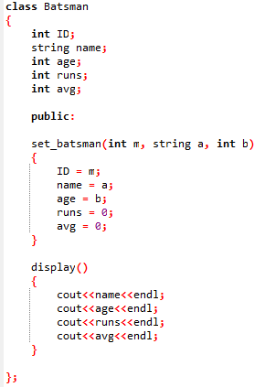
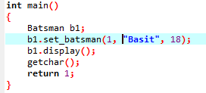
Exercise!

Slide 37
Questions?
Find the name of the batsman(out of three batsmen) who has the highest runs?
Find the name of the batsman with highest average runs?
Find the batsman who has played most matches?

Slide 38
